Slide 1
Segment 8
Recurrences & Backtracking

Slide 2
Recurrences
A recurrence is an equation or inequality that describes a function in terms of its value of smaller inputs.
We have studied the recurrence in detail.
We also known about three methods that are used to solve the recurrences.
Here we will know another method to solve the recurrences, i.e. Recurrence tree method.

Slide 3
Recurrence Trees
Allow you to visualize the process of iterating the recurrence
Allows you make a good guess for the substitution method
Or to organize the bookkeeping for iterating the recurrence
Convert the recurrence into a tree:
  Each node represents the cost of a single subproblem in the set of recursive function invocation.
  Sum up the costs within each level of the tree to obtain a set of pre-level costs.
  Then sum all the pre-level costs to determine the total of all levels of the recursion.

Slide 4
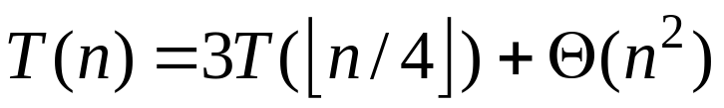
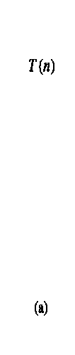
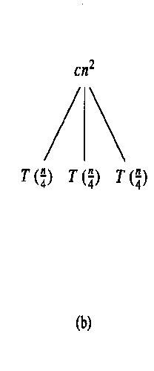
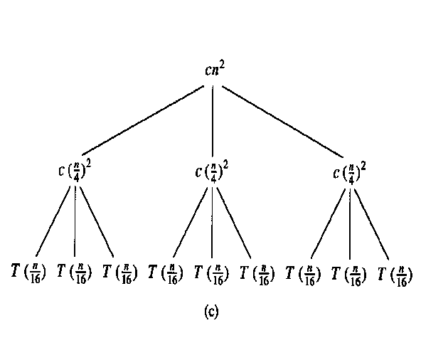
Recursion-tree: Example 1

Slide 5
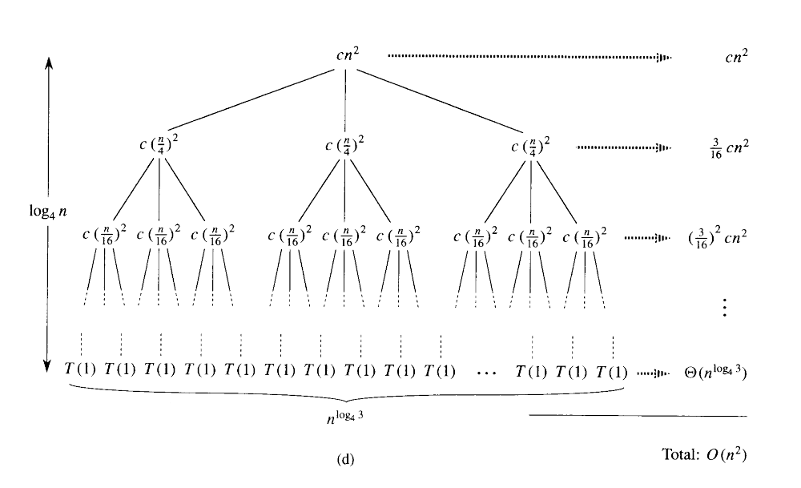
Recursion-tree method

Slide 6


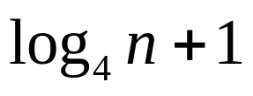


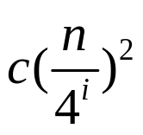
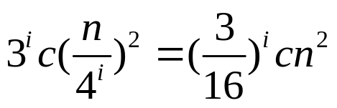
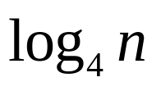

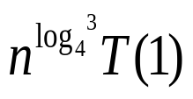
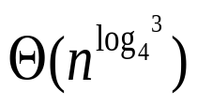
Recursion-tree method
Subproblem size for a node at depth i,
Subproblem size hits n=1 when =1 or when
Total level of tree , (0,1,2,… .)
Number of nodes at depth i ,
Cost of each node at depth i ,
Total cost over all nodes at depth i ,
Last level, at depth , has nodes
and cost is , which is,

Slide 7
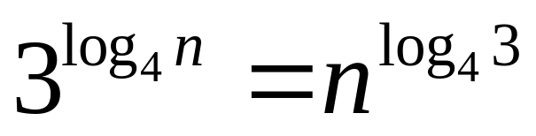
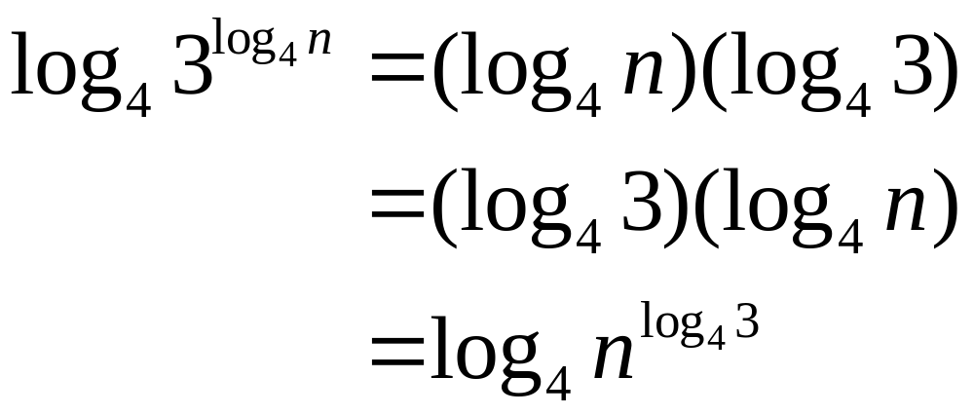
Recursion-tree method
Prove of
We conclude,

Slide 8
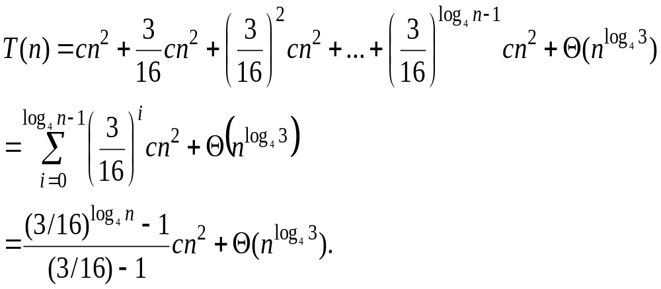
The cost of the entire tree

Slide 9
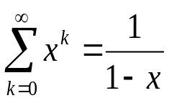
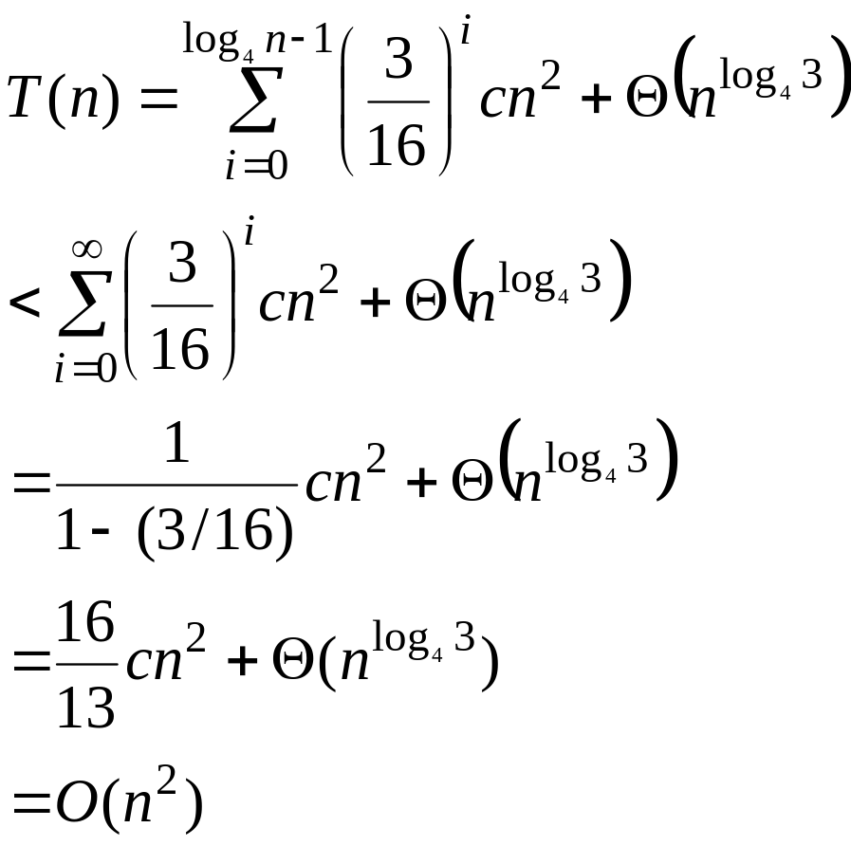
The cost of the entire tree
Backing up one step and applying equation,

Slide 10
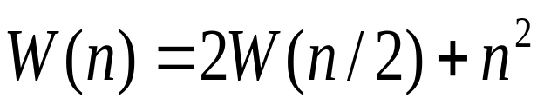
Recurrence Tree: Example 2
n²
n²
n²
W(n/2) W(n/2)
(n/2)² (n/2)²
(n/2)² (n/2)²
W(n/4) W(n/4) W(n/4) W(n/4)
(n/4)² (n/4)² (n/4)² (n/4)²

Slide 11
Recurrence Tree Example
n²
(n/2)² (n/2)²
lg n
(n/4)² (n/4)² (n/4)² (n/4)²
Total: Θ(n²)

Slide 12
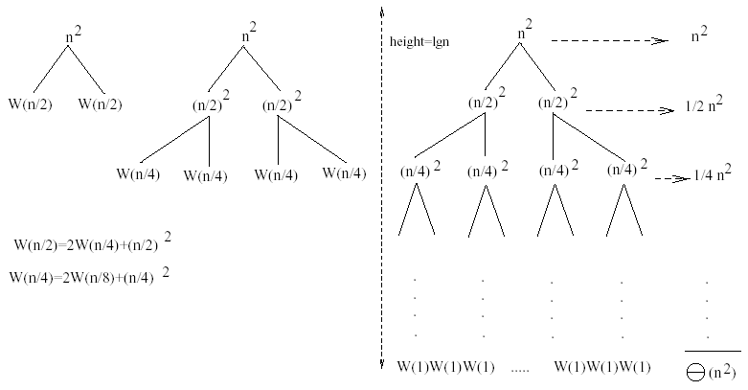

Slide 13
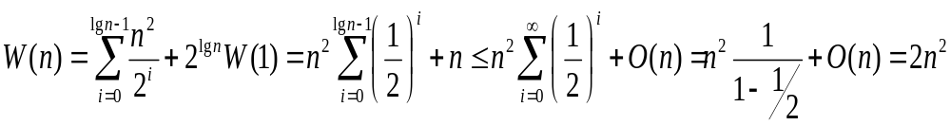
The cost of the entire tree
Subproblem size at level i is: n/2^{i}
Subproblem size hits 1 when n/2^{i}=1 ⇒ i = logn
Total level of tree , logn+1 (0,1,2,… logn.)
Cost of the problem at level i = (n/2^{i})²
No. of nodes at level i = 2^{i}
Total cost:
⇒ W(n) = O(n²)

Slide 14
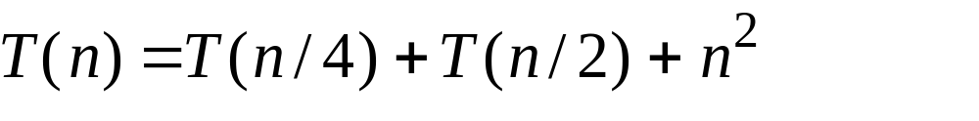
Example 3
n²
n²
n²
5/16 n²
25/256 n²=(5/16)²n²
T(n/4) T(n/2)
(n/4)² (n/2)²
T(n/16) T(n/8) T(n/8) T(n/4)
Since the values decrease geometrically, the total is at most a constant factor more than the largest term and hence the solution is Θ(n²)

Slide 15
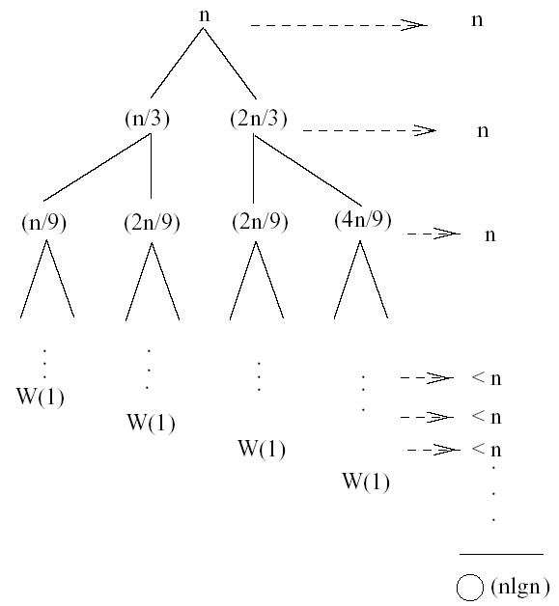
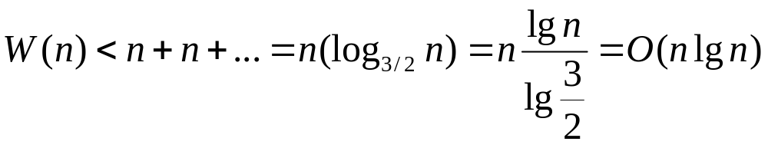
Example 4 (simpler proof)
W(n) = W(n/3) + W(2n/3) + n
The longest path from the root to a leaf is: n → (2/3)n → (2/3)² n → … → 1
Subproblem size hits 1 when 1 = (2/3)^{i}n ⇔ i=log_{3/2}n
Cost of the problem at level i = n
Total cost:
⇒ W(n) = O(nlgn)

Slide 16
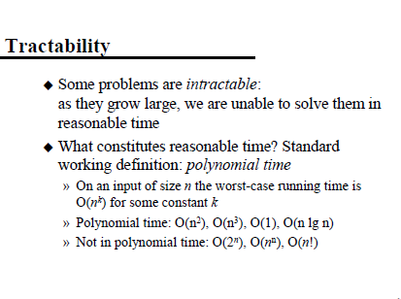
P, NP, NP HARD AND NP – COMPLETE PROBLEMS

Slide 17
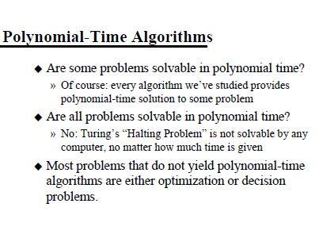

Slide 18
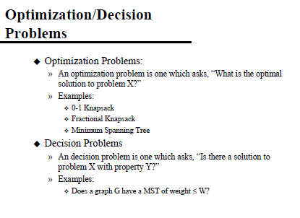

Slide 19
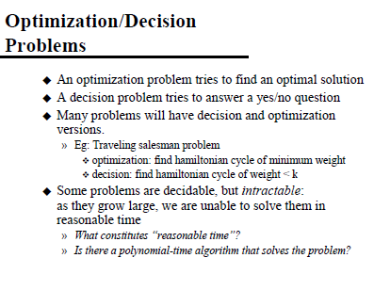

Slide 20
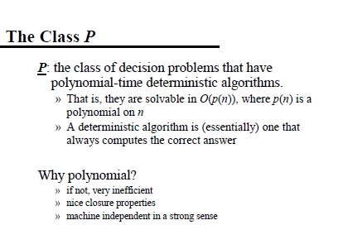

Slide 21
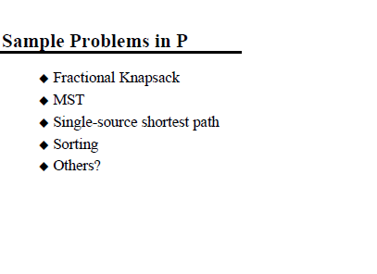

Slide 22
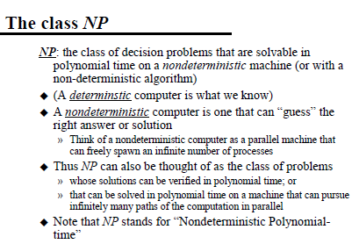

Slide 23
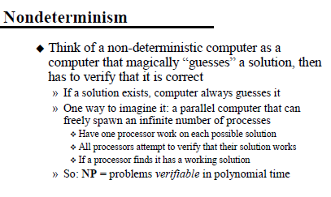

Slide 24
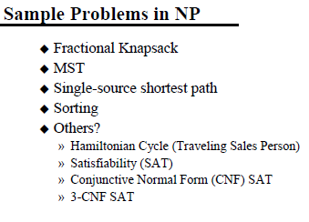

Slide 25
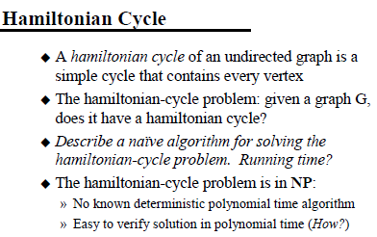

Slide 26
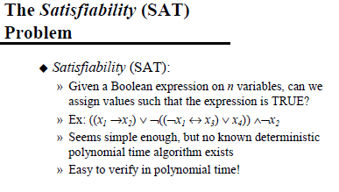

Slide 27
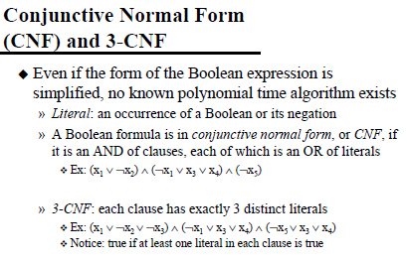

Slide 28
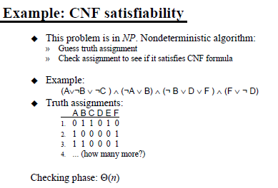

Slide 29
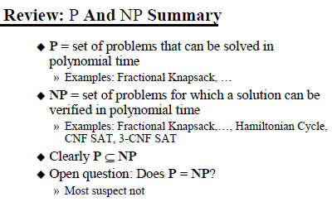

Slide 30
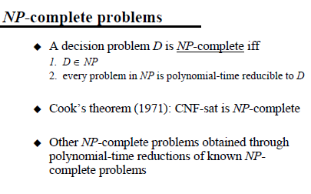

Slide 31
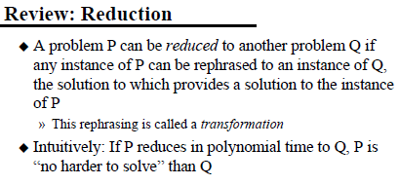

Slide 32
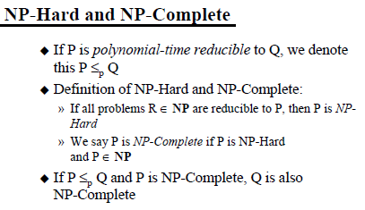

Slide 33
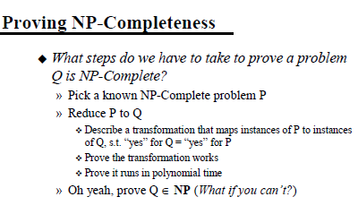

Slide 34
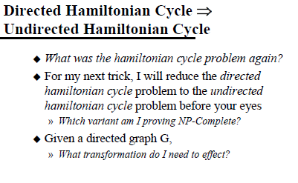

Slide 35
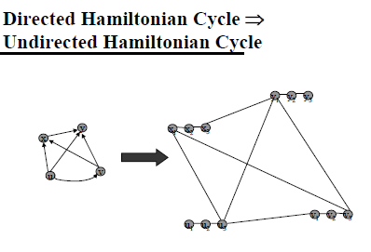

Slide 36
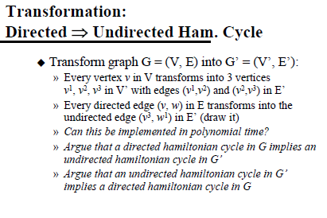

Slide 37
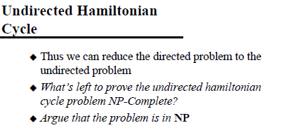

Slide 38
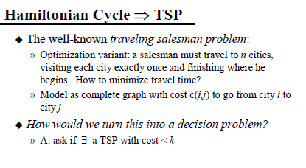

Slide 39
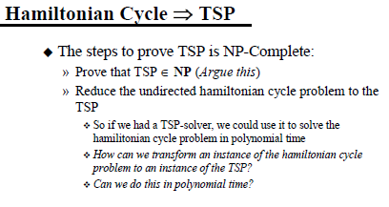

Slide 40
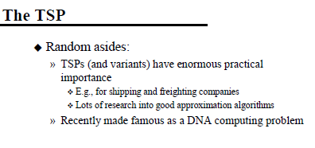

Slide 41
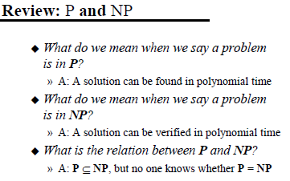

Slide 42
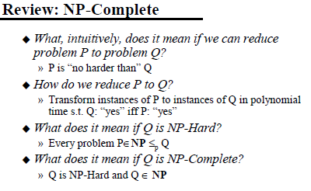
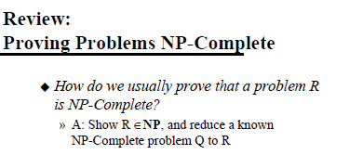

Slide 43


Slide 44


Slide 45
NP-Hard and NP-Complete
NP-hard. A problem Y is NP-hard if, for every problem X in NP, X ≤ _{p} Y.
NP-complete. A problem Y is NP-complete, if it is NP-hard and in NP.
Theorem. Suppose Y is an NP-complete problem. Then Y is solvable in poly-time iff P = NP.
Pf. ⇐ If P = NP then Y can be solved in poly-time since Y is in NP.
Pf. ⇒ Suppose Y can be solved in poly-time.
  Let X be any problem in NP. Since X ≤ _{p} Y, we can solve X in
  poly-time. This implies NP ⊆ P.
  We already know P ⊆ NP. Thus P = NP. ▪
Fundamental question. Do there exist "natural" NP-complete problems?

Slide 46

NP-hard
Hamilton cycle
Steiner tree
Graph 3-coloring
Satisfiability
Maximum clique
…
NP-complete
Matrix permanent
Halting problem
…
NP
Factoring
Graph isomorphism
Minimum circuit size
…
Graph connectivity
Primality testing
Matrix determinant
Linear programming
…
P

Slide 47

Backtracking
Backtracking is a technique used to solve problems with a large search space, by systematically trying and eliminating possibilities.
A standard example of backtracking would be going through a maze.
  At some point in a maze, you might have two options of which direction to go:
Junction
Portion A
Portion B

Slide 48
Backtracking
One strategy would be to try going through Portion A of the maze.
  If you get stuck before you find your way out, then you "backtrack" to the junction.
At this point in time you know that Portion A will NOT lead you out of the maze,
  so you then start searching in Portion B
Junction
Portion B
Portion A

Slide 49

Backtracking
Clearly, at a single junction you could have even more than 2 choices.
The backtracking strategy says to try each choice, one after the other,
  if you ever get stuck, "backtrack" to the junction and try the next choice.
If you try all choices and never found a way out, then there IS no solution to the maze.
Junction
C
B
A

Slide 50
Backtracking
Backtracking is the problem-solving method in which the solution space is scanned, but with the additional condition that only the possible candidate solutions are considered.
Backtracking is a general algorithm for finding all (or some)solutions to some computational problem that incrementally builds candidates to the solutions, and abandons each partial candidate c ("backtracks") as soon as it determines that c cannot possibly be completed to a valid solution.
Suppose you have to make a series of decisions, among various choices, where
  You don’t have enough information to know what to choose
  Each decision leads to a new set of choices
  Some sequence of choices (possibly more than one) may be a solution to your problem
-Backtracking is a methodical way of trying out various sequences of decisions, until you find one that “works”

Slide 51
The n-Queens Problem
The problem is to place n queens (chess pieces) on an n by n board so that no two queens are in the same row, column or diagonal
The 4 by 4 board above shows a solution for n = 4
The text gives an explicit construction for a solution for each n ≥ 4
But first we will introduce an algorithm strategy called backtracking, which can be used to construct all solutions for a given n.
x
x
x
x
x
x
x
x
x
 |  | Q
Q
 |  |  | Q
 | Q
x
x
x
Q
x
x
x
x
x
x
x
x
x
x
x
x
x
x
x

Slide 52
4-queen Solution Space
1
x₁=1
X₁=2
X₁=3
X₁=4
2
18
34
50
2
3
4
1
3
4
1
2
4
1
2
3
3
8
13
19
24
29
35
40
45
51
56
61
3
4
2
4
2
3
3
4
1
4
1
3
2
4
1
4
1
2
2
3
1
3
1
2
4
6
9
11
14
16
20
22
25
27
30
32
36
38
41
43
46
48
52
54
57
59
62
64
4
3
4
2
3
2
4
3
4
1
3
1
4
2
4
1
2
1
3
2
3
1
2
1
5
7
10
12
15
17
21
23
26
28
31
33
37
39
42
44
47
49
53
55
58
60
63
65

Slide 53
Backtracking Solution to n-Queens Problem
We can solve this problem by generating a dynamic tree in a depth-first manner
We will try to place a queen in each column from the first to the last
For each column, we must select a row
We start by placing a queen in row 1 of the first column
Then we check the rows in the second column for positions that do not conflict with our choice for the first column
After placing a queen in the second column, we continue to the third, etc.
If at any point we find we cannot place a queen in the current column, we back up to the previous column and try a different row for that column
We then continue trying to place more queens
This process can be visualized by a tree of configurations
The nodes are partial solutions of the problem
The root is an empty board
The children of the root will be boards with placements in the first column
We will generate the nodes of the tree dynamically in a depth-first way

Slide 54
4-queen Solution during backtracking
1
x₁=1
X₁=2
2
18
x₂=2
X₂=3
X₂=4
X₂=1
X₂=3
X₂=4
3
8
13
19
24
29
B
B
B
x₃=2
x₃=4
x₃=2
x₃=3
X₃=1
9
11
14
16
 | 1
 |  |  | 2
3
 |  | 4
30
B
B
B
X₄=3
X₄=3
15
31
B

Slide 55
Backtracking Solution to n-Queens Problem
We could continue with the previous example to obtain all possible solutions for n = 4
Our goal now is to convert this approach into an explicit algorithm with n queens.
Consider an nxn chessboard and try to find all ways to place n nonattacking queens.
We track the position of the queens by using an array row
We observed from the 4-queens problem that we can let (x₁,. . . ,x_{n} ) represent a solution in which x_{i} is the column of the ith row where the ith queen is placed.
The x_{i}‘s will all be distinct since no two queens can be placed in the same column.
Now how do we test whether two queens are on the same diagonal?

Slide 56
Backtracking Solution to n-Queens Problem
Test whether two queens are on the same diagonal?
Imagine the chessboard squares being numbered as the indices of the two-dimensional array a[1:n, 1:n].
Observe that every element on the same diagonal that runs from the upper left to the lower right has the same (row-column) value.
Every element on the same diagonal that goes from the upper right to the lower left has the same (row+column) value.
Suppose two queens are placed at position (i,j) and (k,l). Then they are on the the same diagonal only if
i-j=k-l or i+j=k+l that is j-l=i-k or j-l=k-I
Therefore, two queens lie on the same diagonal in and only if
|j-l|=|i-k|
The algorithm is invocked by Nqueen(1,n).

Slide 57
N-Queen Algorithm
Algorithm Place(k,i)
/*Returns true if a queen can be placed in kth row and ith column. Otherwise it returns false.*/
{
for j:=1 to k-1 do
if((x[j]==i) or (abs(x[j]-i)=abs(j-k)) //Two same column or Same diagonal
then return false
return true.
}
Algorithm NQueens(k,n)
//Using backtracking, this procedure prints all possible placements of n queens
{
for i:=1 to n do
{
if(place(k,i))then
{
x[k]:=i;
if(k=n) then write(x[1:n]);
else NQueens(k+1,n);
}
}
}

Slide 58
Running Time
Improvements can be made so that Place(k,i) runs in O(1) time rather than O(k) time.
We will will obtain an upper bound for the running time of our algorithm by bounding the number of times NQueens(k,n) is called for each k<n
  k = 1: 1 time, by n_queens
  1 < k < n: at most n(n-1)⋅⋅⋅(n-k+2), since there are n(n-1)⋅⋅⋅(n-k+2) ways to place queens in the first k-1 columns in distinct rows
Ignoring recursive calls, NQueens(k,n) executes in Θ(n) time for k < n.
This gives a worst-case bound for NQueens(k,n) of
n [ n(n-1)⋅⋅⋅(n-k+2) ] for 1 < k < n
For k = n, there is at most one placement possible for the queen. Also, the loop in NQueens executes in Θ(n) time.
There are n(n-1)⋅⋅⋅2 ways for the queens to have been placed in the first n-1 columns, so the worst case time for NQueens(n,n) is
n [ n(n-1)⋅⋅⋅2 ]

Slide 59

Running Time
Combining the previous bounds, we get the bound
n [ 1 + n + n(n-1) + ⋅⋅⋅ + n(n-1) ⋅⋅⋅2]
= n⋅n! [ 1/n! + 1/(n-1)! + ⋅⋅⋅ + 1/1! ]
A result from calculus:
This means that n⋅n! [ 1/n! + 1/(n-1)! + ⋅⋅⋅ + 1/1! ] ≤ n⋅n! (e-1)
We thus have that our algorithm runs in O(n⋅n!) time

Slide 60
Branch-and-Bound
Effective for optimization problems
Extended Backtracking Algorithm
Instead of stopping once a single solution is found, continue searching until the best solution is found
Has a scoring mechanism to choose most promising configuration in each iteration

Slide 61

Branch-and-Bound
The branch-and-bound problem solving method is very similar to backtracking in that a state space tree is used to solve a problem. The differences are that B&B
does not limit us to any particular way of traversing the tree and
(2) is used only for optimization problems.
A B&B algorithm computes a number (bound) at a node to determine whether the node is promising. The number is a bound on the value of the solution that could be obtained by expanding the state space tree beyond the current node.

Slide 62
Branch-and-Bound
Types of Traversal
When implementing the branch-and-bound approach there is no restriction on the type of state-space tree traversal used. Backtracking, for example, is a simple type of B&B that uses depth-first search.
A better approach is to check all the nodes reachable from the currently active node (breadth-first) and then to choose the most promising node (best-first) to expand next.
An essential element of B&B is a greedy way to estimate the value of choosing one node over another. This is called the bound or bounding heuristic. It is an underestimate for a minimal search and an overestimate for a maximal search.
When performing a breadth-first traversal, the bound is used only to prune the unpromising nodes from the state-space tree. In a best-first traversal the bound cab also used to order the promising nodes on the live-node list.

Slide 63

Traveling Salesperson & B&B
In the most general case the distances between each pair of cities is a positive value with dist(A,B) /= dist(B,A). In the matrix representation, the main diagonal values are omitted (i.e. dist(A,A) = 0).

Slide 64

Traveling Salesperson & B&B
Obtaining an Initial Tour Use the greedy method to find an initial candidate tour. We start with city A (arbitrary) and choose the closest city (in this case E). Moving to the newly chosen city, we always choose the closest city that has not yet been chosen until we return to A.
Our candidate tour is
A-E-C-G-F-D-B-H-A
with a tour length of 28. We know that a minimal tour will be no greater than this.
It is important to understand that the initial candidate tour is not necessarily a minimal tour nor is it unique.
If we start with city E for example, we have,
E-A-B-H-C-G-F-D-E
with a length of 30

Slide 65

Traveling Salesperson & B&B
Defining a Bounding Heuristic
Now we must define a bounding heuristic that provides an underestimate of the cost to complete a tour from any node using local information. In this example we choose to use the actual cost to reach a node plus the minimum cost from every remaining node as our bounding heuristic.
h(x) = a(x) + g(x)
a(x) - actual cost to node x
g(x) - minimum cost to complete
Since we know the minimum cost from each node to anywhere we know that the minimal tour cannot be less than 25.

Slide 66

Finding the Minimal Tour
1. Starting with node A determine the actual cost to each of the other nodes.
2. Now compute the minimum cost from every other node 25-4=21.
3. Add the actual cost to a node a(x) to the minimum cost from every other node to determine a lower bound for tours from A through B,C,. . ., H.
4. Since we already have a candidate tour of 28 we can prune all branches with a lower-bound that is ? 28. This leaves B, D and E as the only promising nodes.
5. We continue to expand the promising nodes in a best-first order (E1,B1,,D1).

Slide 67

5. We continue to expand the promising nodes in a best-first order (E1,B1,,D1).

Slide 68

6. We have fully expanded node E so it is removed from our live-node list and we have two new nodes to add to the list. When two nodes have the same bounding values we will choose the one that is closer to the solution. So the order of nodes in our live-node list is (C2,B1,B2,D1).

Slide 69

7. We remove node C2 and add node G3 to the live-node list. (G3,B1,B2,D1).

Slide 70

8. Expanding node G gives us two more promising nodes F4 and H4. Our live-node list is now (F4,B1,H4,B2,D1).

Slide 71

9. A 1st level node has moved to the front of the live-node list. (B1,D5,H4,B2,D1)
10. (H2,D5,H4,B2,D1)
11. (D5,H4,B2,D1)
12. (H4,B2,D1)
13. (B2,D1)
14. (H3,D1)

Slide 72

15. (D1)

Slide 73

16.We have verified that a minimal tour has length >= 28. Since our candidate tour has a length of 28 we now know that it is a minimal tour, we can use it without further searching of the state-space tree.

Slide 74

Another Example
In the previous example the initial candidate tour turns out to be a minimal tour. This is usually not the case. We will now look at problem for which the initial candidate tour is not a minimal tour.
The initial tour is A-F-E-D-B-C-A with a total length of 32. The sum of the minimum costs of leaving every node is 29 so we know that a minimal tour cannot have length less than 29.

Slide 75

The live-node list is ordered by bounding value and then by level of completion. That is, if two nodes have the same bounding value we place the one that is closer to completion ahead of the other node. This is because the bounding value of the of the node closer to completion is more likely to be closer to the actual tour length.

Slide 76

The node shown in red were expanded from an active node (F₃) with a possible tour length of 29. However the completed tours turned out to be significantly larger.

Slide 77

Expanding D₃ we find an actual tour that is shorter than our initial tour. We do not yet know if this is a minimal tour but we can remove nodes from our live-node list that have a bounding value of >= 31. Now we expand D₂ to find that it leads to tours of length >= 33.

Slide 78

Expansion of E₂ eliminates this path as a candidate for a minimal tour.

Slide 79

When the live-node list is empty we are finished. In this example a minmal tour is A-C-E-D-B-F-A with a length of 31 we have found a tour that is shorter than the original candidate tour.

Slide 80
Branch and bound Applications
This approach is used for a number of NP-hard problems, such
as
Knapsack problem
Integer programming
Nonlinear programming
Traveling salesman problem (TSP)
Quadratic assignment problem (QAP)
Maximum satisfiability problem (MAX-SAT)
Nearest neighbor search (NNS)
Cutting stock problem
False noise analysis (FNA)
Computational phylogenetics

